Slide 1


Conversational AI for Instant Business Intelligence Dashboards
By:-
TechCyber
Anirban Ray
Anusmita Ray Chaudhuri

Slide 2
Problem Statement
In modern organizations, accessing data-driven insights is still a challenge:
Non-technical users cannot write SQL queries
BI tools are powerful but difficult to navigate
Data teams are overloaded with repetitive reporting requests
This creates a bottleneck where:
Simple insights take hours or days to generate
Decision-making becomes slow and reactive
Business agility is significantly impacted

Slide 3
Objective
Design an intelligent analytics system that:
Eliminates the need for SQL by understanding natural language queries
Instantly fetches precise data from underlying databases
Dynamically creates interactive dashboards with minimal user effort
Outcome:
Transform complex data analysis into a simple, conversational experience

Slide 4
Target User (CXO)
Target User: Business Executives (CXOs)
Need real-time insights to drive strategic decisions
Cannot interact directly with databases or write SQL queries
Face delays due to dependency on data analysts
Pain Point:
Limited access to instant insights slows down business agility
Goal:
Enable seamless, self-service analytics through conversational AI

Slide 5
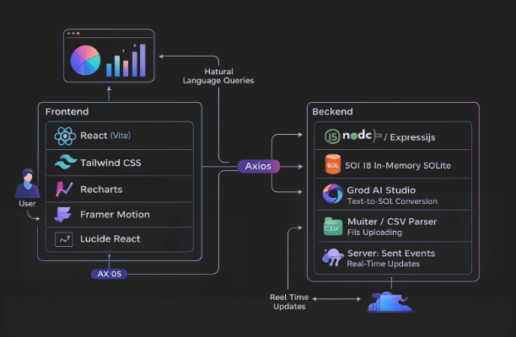
System Overview

Slide 6
Tech Stacks
🎨 Frontend (User Interface Layer)
React (Vite) Fast, component-based UI development with optimized performance
Tailwind CSS Modern styling with glass morphism, gradients, and responsive design
Recharts Interactive and dynamic data visualization (bar, line, pie charts)
Framer Motion Smooth animations and transitions for better user experience
Lucide React Clean and modern icon library
Axios Handles API requests between frontend and backend
⚙️ Backend (Processing & Logic Layer)
Node.js + Express.js Backend server handling API requests and business logic
sql.js (WebAssembly SQLite) In-memory database for ultra-fast query execution
Groq AI Studio Converts natural language → SQL queries and generates insights
Multer + CSV Parser Handles file uploads and converts CSV → database schema
Server-Sent Events (SSE) Enables real-time updates from backend to frontend

Slide 7
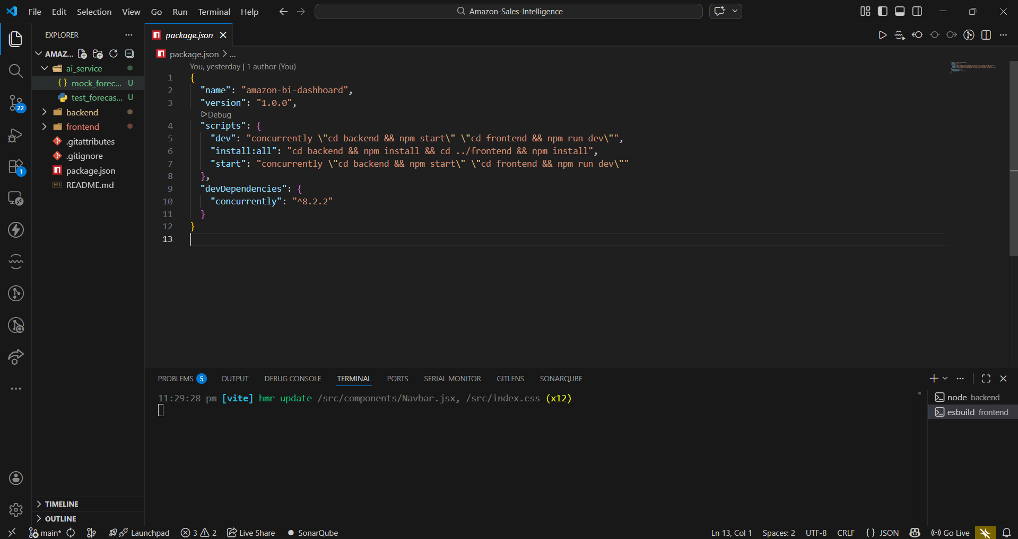
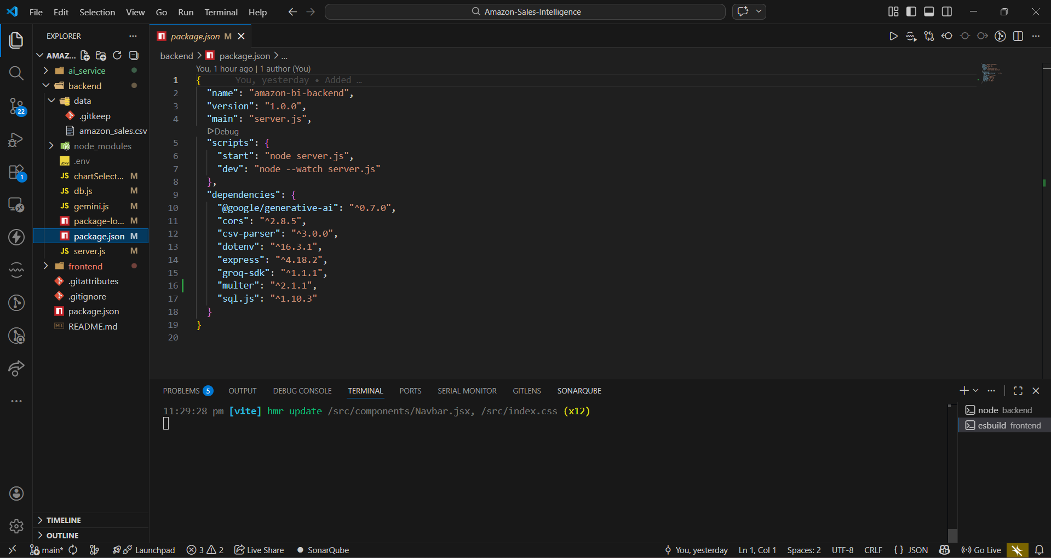
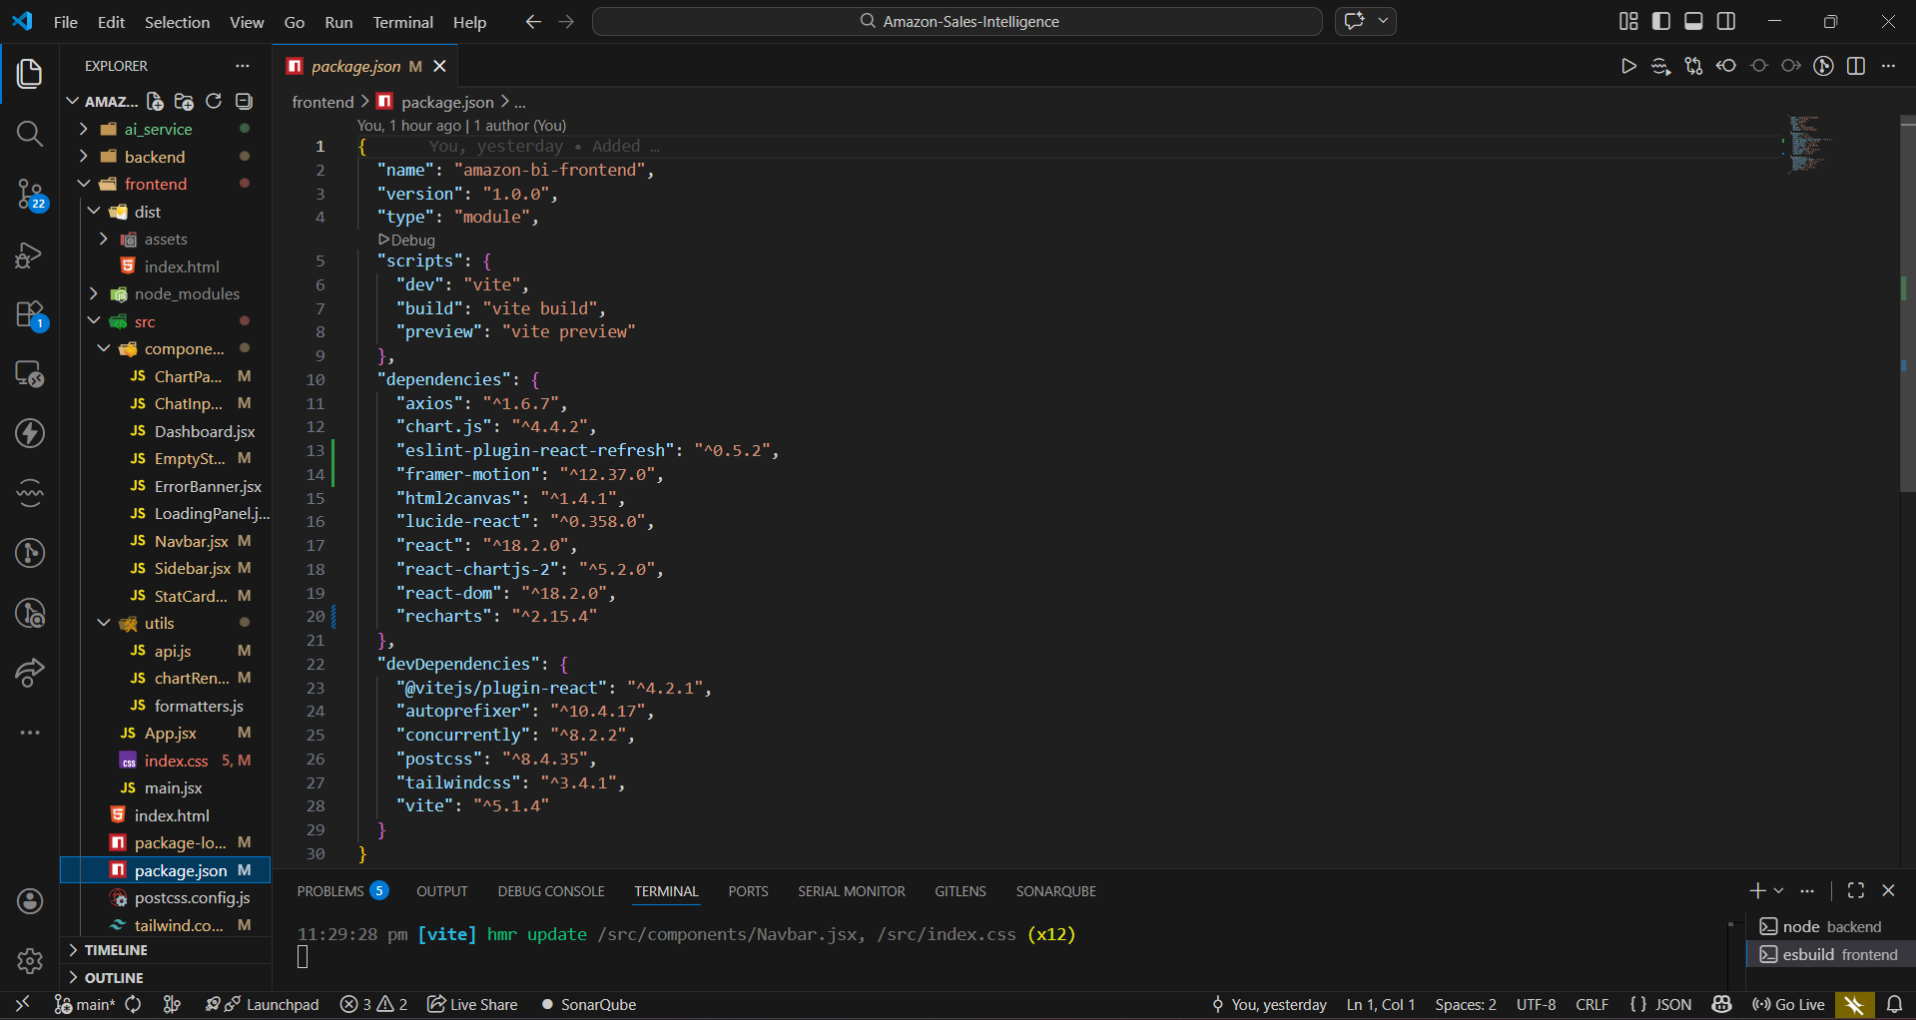
Architecture

Slide 8
Key Features
Conversational Query Interface
Enables users to interact with data using simple, natural language
AI-Driven SQL Generation
Eliminates the need for manual querying by automatically generating optimized SQL
Intelligent Visualization Engine
Selects the most relevant chart type (bar, line, pie) based on data patterns
Real-Time Interactive Dashboards
Provides dynamic and responsive visualizations for better decision-making
Data-Agnostic Design (CSV Upload)
Supports custom datasets, making the system flexible and scalable
Context-Aware Query History
Allows users to refine and build upon previous queries for deeper insights

Slide 9
Accuracy & Intelligence
Schema-Aware AI Understanding
The model is guided by the dataset schema to reduce incorrect query generation
Pre-Execution SQL Validation
Queries are verified before execution to avoid runtime failures
Intelligent Visualization Logic
Automatically selects the most appropriate chart type based on data patterns
Graceful Error Handling
Detects invalid or unclear queries and responds with helpful suggestions instead of failing
Outcome:
Delivers trustworthy insights with high accuracy and minimal errors

Slide 10
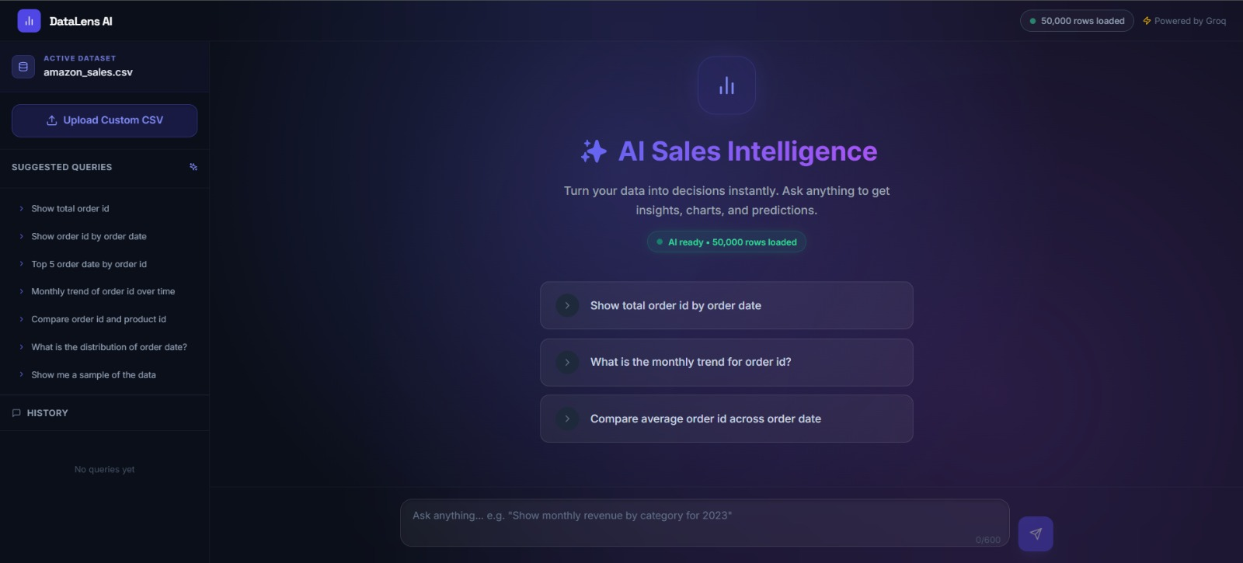
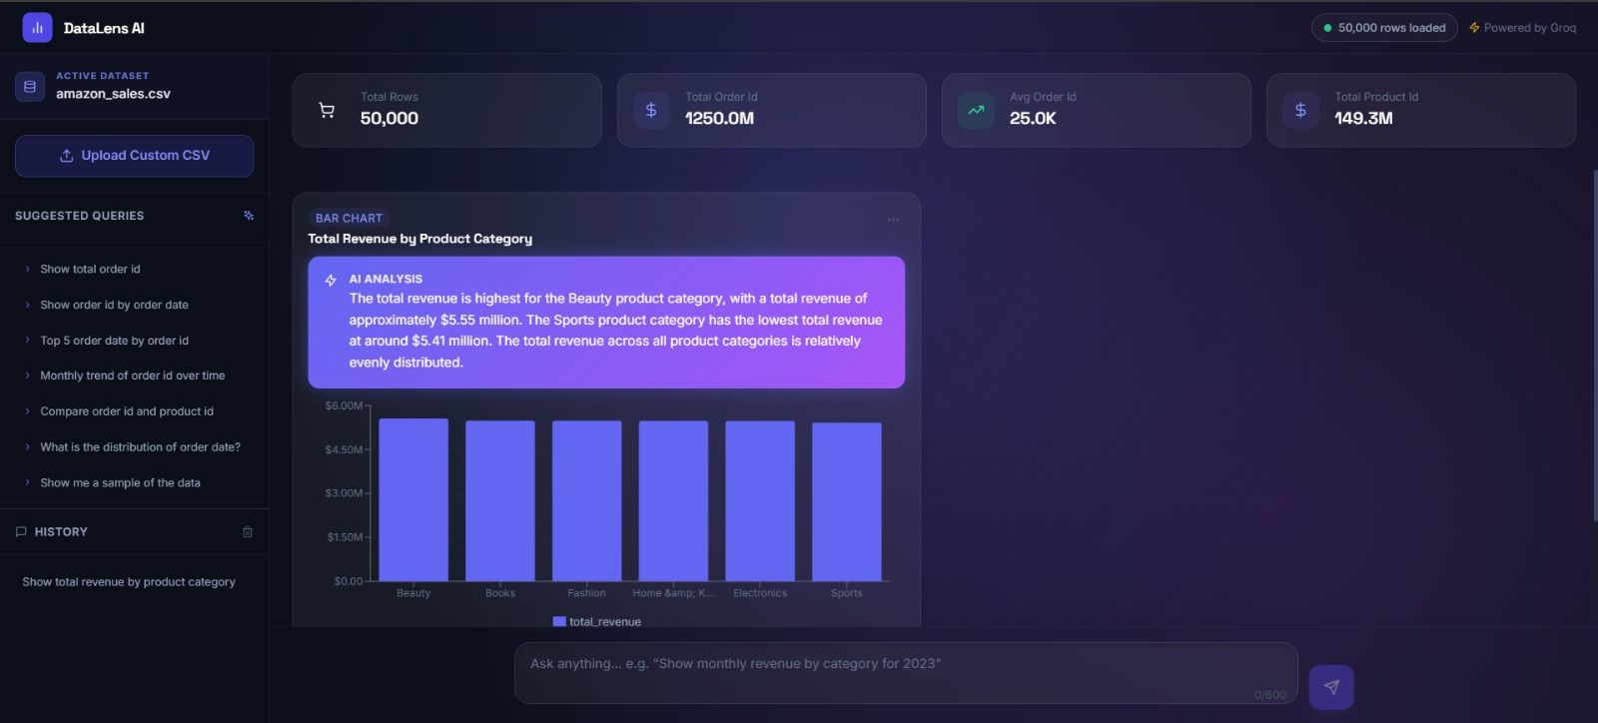
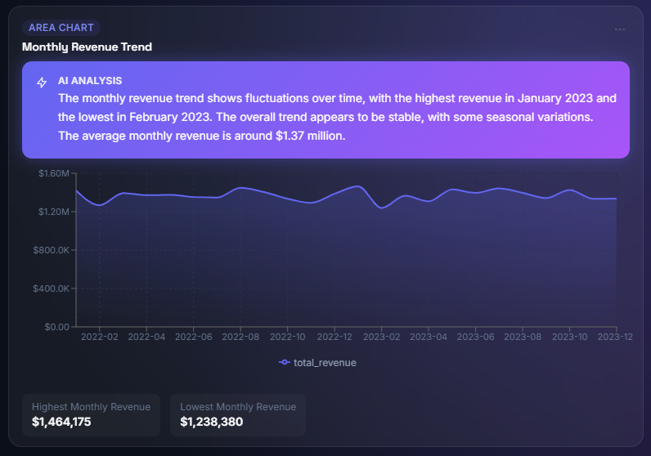
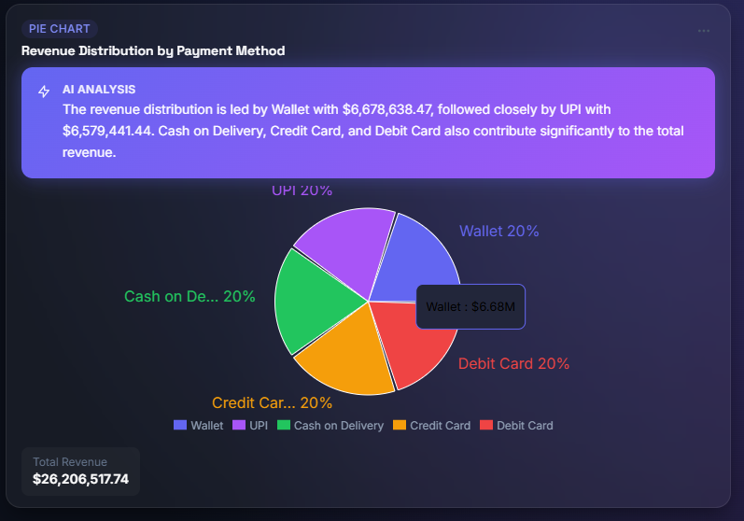
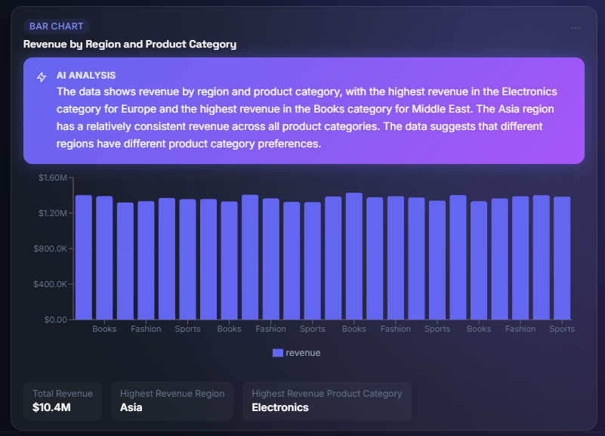
UI / UX with Demo Queries

Slide 11
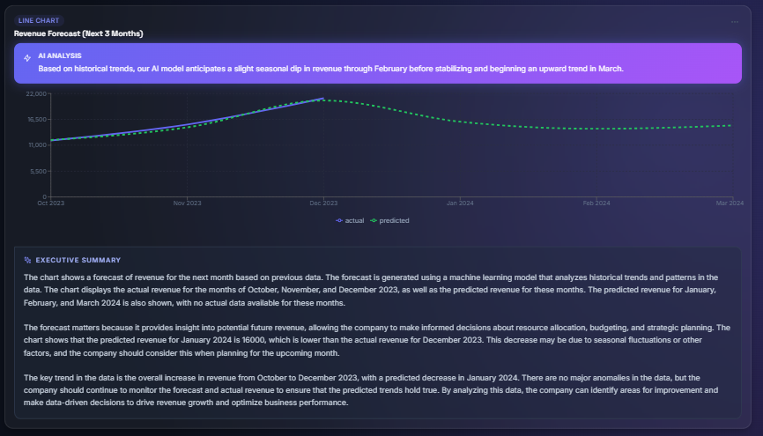
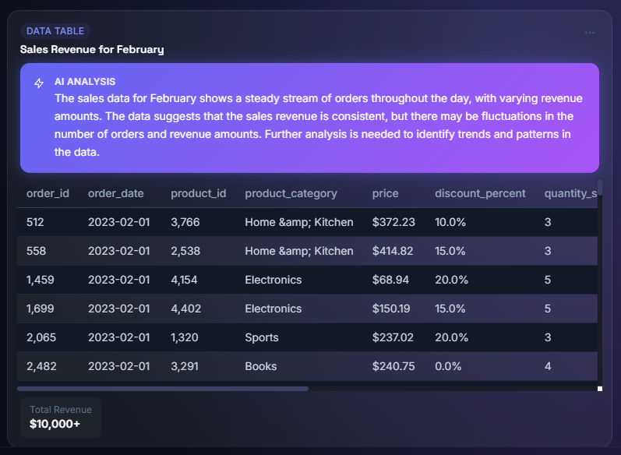
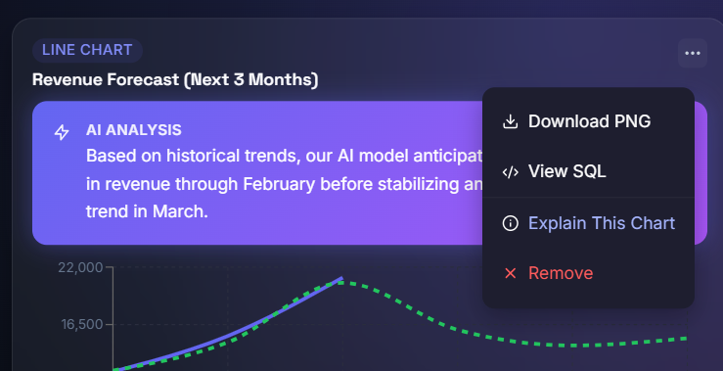
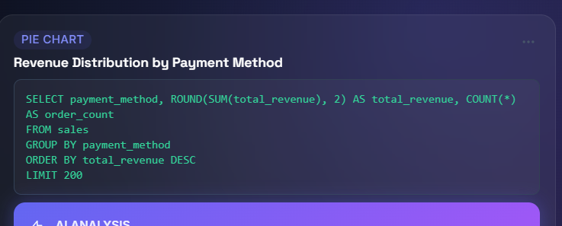
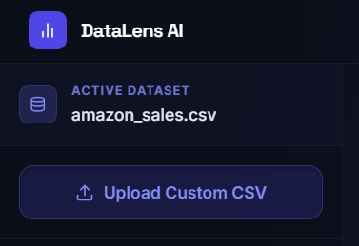
More UI/UX

Slide 12
Innovation
AI-Driven Analytics Engine
Transforms business questions into insights using advanced language models
Zero-Code Data Interaction
Removes the need for SQL or technical expertise
Instant Insight Generation
Delivers real-time dashboards without manual configuration
Flexible & Scalable Design
Works with any dataset through dynamic CSV ingestion
Conversational Intelligence
Supports follow-up queries, enabling deeper and more intuitive data exploration

Slide 13
Future Scope
Conversational Drill-Down
Support dynamic follow-up queries for deeper and more contextual data exploration
Rich Multi-Visualization Dashboards
Display multiple charts simultaneously for holistic insights
Voice-Enabled Analytics
Introduce speech-based interaction for a seamless user experience
Real-Time Data Integration
Connect with live enterprise databases and APIs for up-to-date insights
AI-Generated Insights & Predictions
Deliver automated explanations, trends, and future forecasts using advanced AI models

Slide 14
Conclusion
Bridging the gap between business users and complex data systems
Converting simple questions into meaningful insights using AI
Enabling real-time, intelligent decision-making through automated dashboards

